Slide 1
Sentiment Analysis of App reviews from Google Play Store
Capstone Project: May 2021
Isaac Kar Wai Low, Data Scientist

Slide 2
Agenda
Bio
Project Context
Define
Design
Deliver
Summary, conclusions and next steps
Appendix: list of supporting documents

Slide 3
Bio
Education
Masters of Information Technology
Professional Experience
Experience in data engineering at a start-up called Possible Me
NLP
Google Cloud Platform (GCP)
ANZ virtual internship project on GitHub
25+ features engineered
IOD
Heroku
Feature Engineering
Mathematics and Statistical Methods

Slide 4
Project context
Industry or domain
Application software development: Android and iOS, mobile, and web
Problem area
Possible Me has problems with product prioritization and feature prioritization
Problems
Agile problems
Product Owner ignores scope creep
Manager is pressured with budget deadlines
Requirements Analysts and Software developers are constantly awaiting approval
Value proposition
Need dashboard/ metric to measure real time customer sentiment to prioritize product and features

Slide 5
Define
Business aspects
Stakeholders: Customers, Manager, Product Owner, Requirements Analysts, UI/UX Designers, Web Developers, Java developers, IT Project Manager, Financial Manager, Marketing Manager, Data Engineers, Data Analysts.
Business question: How to increase delivery cycle speeds and boost revenue by prioritizing product and features?
Stakeholder & ROI/Dollar Value:
Reduce mean time to restoration for cycle times
Goals
To help the product owner and manager manage scope creep
To increase gross profit

Slide 6
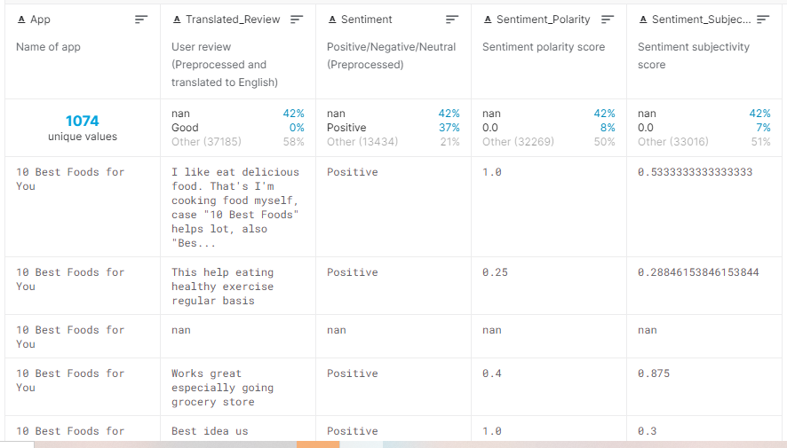
Kaggle dataset

Slide 7
Define
Data Science aspects
Accuracy, Precision and ROC Score
Classification Problem: Multiclass and Binary
Dependent Variable (X), Customer reviews: text string type
Independent Variable (Y), Sentiment label: binary
Data Sourced
Kaggle: https://www.kaggle.com/ashraf1997/anz-synthesised-transaction-dataset
Google Play Scrapping: https://play.google.com/store
Python API: https://pypi.org/project/google-play-scraper/

Slide 8
Define
Data Quality
Volume
Dense instead of sparse
Rows: 64,295
Columns: 5
Variety
The dataset contains 1074 Google Play Mobile Apps with Reviews ranging from 30 -320 per app.
The sentiment labels have 3 categories, negative, neutral, and positive labelled in a set {-1, 0, 1}.
Polarity and Subjectivity scores allow more accurate models. But it is ignored in our case study because we are not doing information retrieval

Slide 9
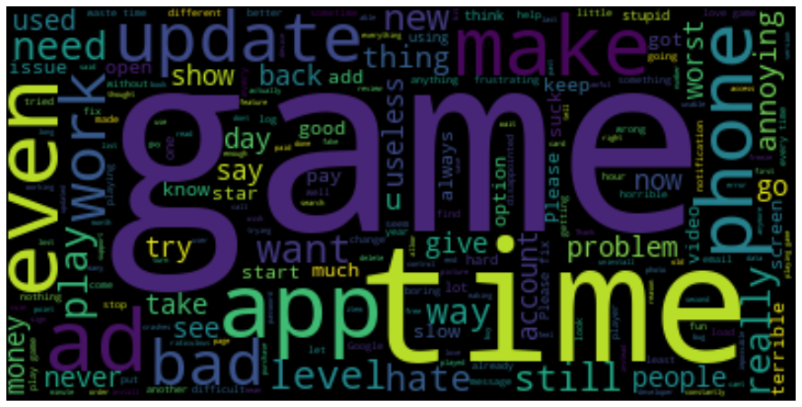
Design
Data exploration, analysis and visualization (EDA)
Negative Cloud

Slide 10
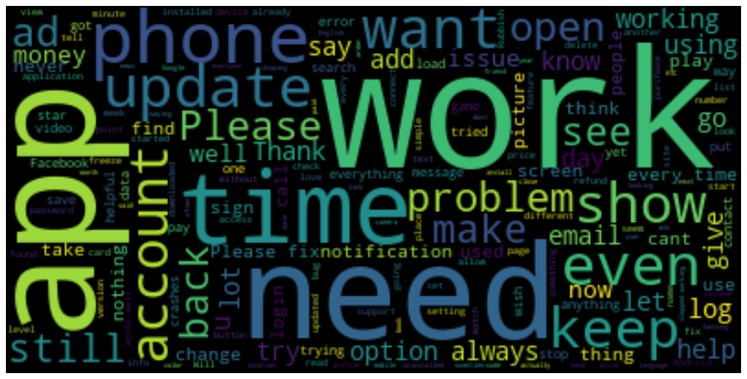
Design
Neutral Cloud

Slide 11
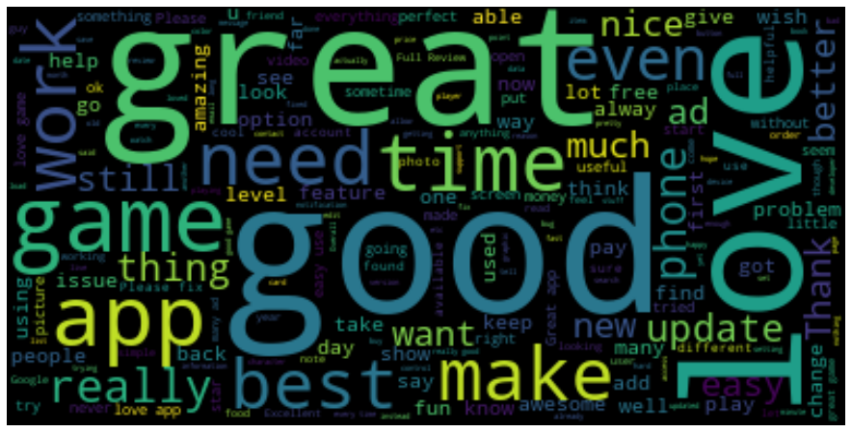
Design
Positive Cloud

Slide 12
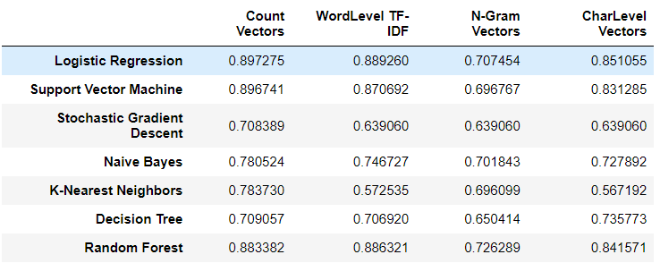
Features vs Models

Slide 13
Deliver
Feature Engineering
Count Vectorizers (bag-of-words), Word Level TFIDF, n-gram level TFIDF, Char level TFIDF
The comparisons on the table show the accuracies of a multiclass problem
Accuracies are good to determine importance of features,
Count Vectorizer performed the best overall
Machine Learning models used and evaluation metrics
Logistic Regression, SVM, SGD, Naïve Bayes, KNN, Decision Tree, Random Forest
Accuracy, ROC score
The ROC curves show precision instead of accuracy, as focus is now on the performance on the model’s predictive value.
Predictive measures are better for sentiment analysis as this is not a case in information retrieval.

Slide 14
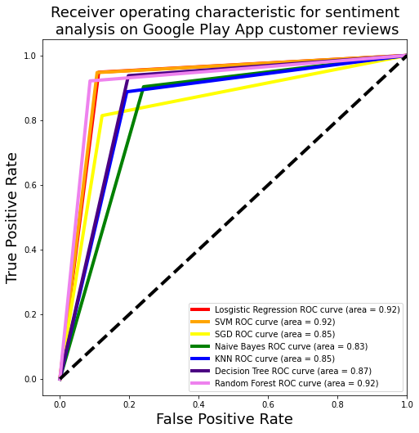
ROC curve comparisons
Logistic Regression, SVM and Random Forest all seem to have the same precision scores
Training time (G for GridSearch fit):
Log regression: 49.8s (G)
SVC: 28.5s (G)
SGD: 29.5s (G)
NB: 459 ms (G)
KNN: 8 min 6s (G)
Decision Tree: 12min 35 s
Random Forest: 1min 13s

Slide 15
Ingesting new data with a pipeline
from google_play_scraper import app
from print_dict import pd as prtd
app_ids = ['com.mobincube.ndis_provider_directory.sc_592DRC&showAllReviews=true', 'com.planready',
'com.mysalesforce.mycommunity.C00D7F000003E7pqUAC.A0OT7F0000004C94WAE',
'au.com.myplanmanager&showAllReviews=true',
'com.planready.ucq', 'com.itelasoft.PlanTracker&showAllReviews=true',
'com.ionicframework.bettercaring45581069&showAllReviews=true',
'com.mysalesforce.mycommunity.C00D7F000004cbJAUAY.A0OT2P000000000HWAQ&showAllReviews=true',
'au.gov.dhs.expressplus.medicare&showAllReviews=true'
]
%%time
df, logs = get_dictionary(app_ids)
Wall time: 4.67 s

Slide 16
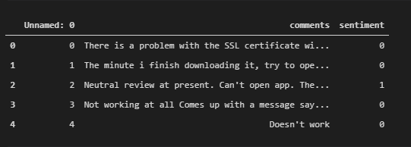
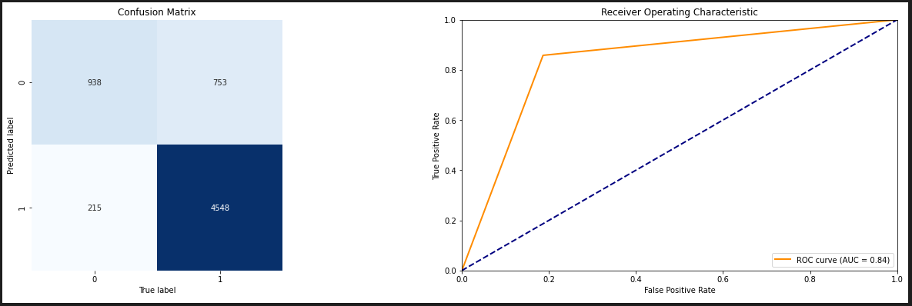
New review data

Slide 17
Summary, conclusions and next steps
Summary
My data solution is a first step in addressing company wide problems. It starts with addressing salient needs proposed by the IT teams in terms of product and feature prioritization
Conclusions
Count Vectorizers and Linear SVC is a very good combination for predicting sentiment for new customer review data in the Google Play Store. However, other mobile platforms may still need addressing
Next steps
The data pipeline needs further consolidation in terms of API calls and app_id inputs
A better labelling system for new data should be implemented. Perhaps a webhook to translate ratings into sentiment labels

Slide 18
Appendix
References
https://www.grandviewresearch.com/industry-analysis/mobile-application-market
https://agilemanifesto.org/
https://www.investopedia.com/terms/v/valuechain.asp
https://techgeek365.com/5-software-development-concepts-to-improve-your-programming/
https://www.lexalytics.com/lexablog/sentiment-accuracy-baseline-testing
https://www.stitchdata.com/resources/what-is-data-pipeline/
https://www.kaggle.com/ashraf1997/anz-synthesised-transaction-dataset
https://play.google.com/store
https://pypi.org/project/google-play-scraper/

